Slide 1

Maharashtra Institute of Technology, Aurangabad
Department of Computer Science and Engineering
Internship Review 01: Zensar Technologies Limited, Pune
Mentor :- Dr. Smita Kasar
Name of Student :- Abhishek Hole (15)

Slide 2

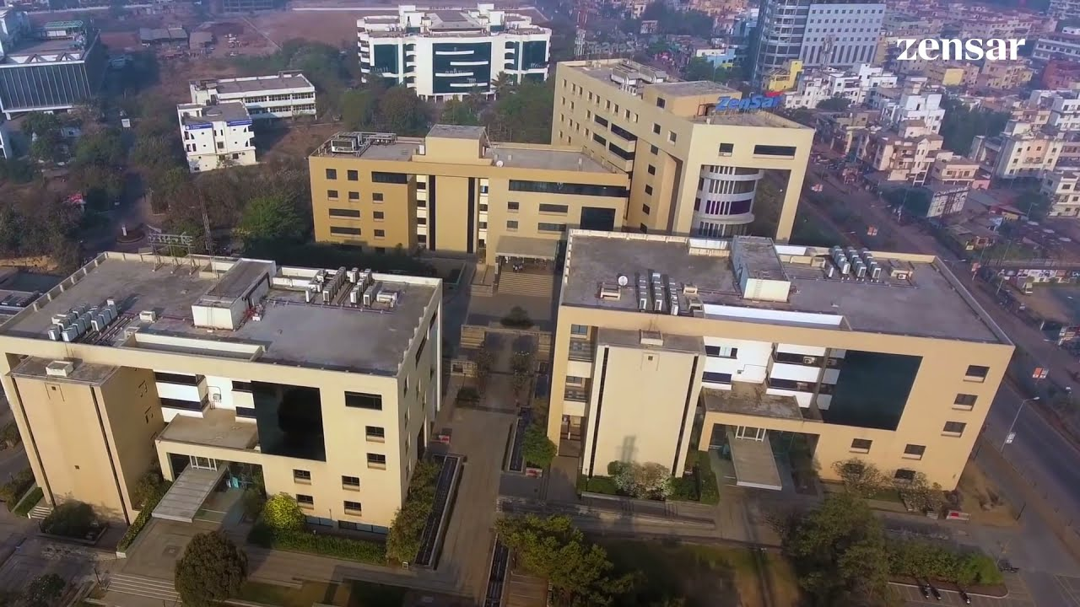

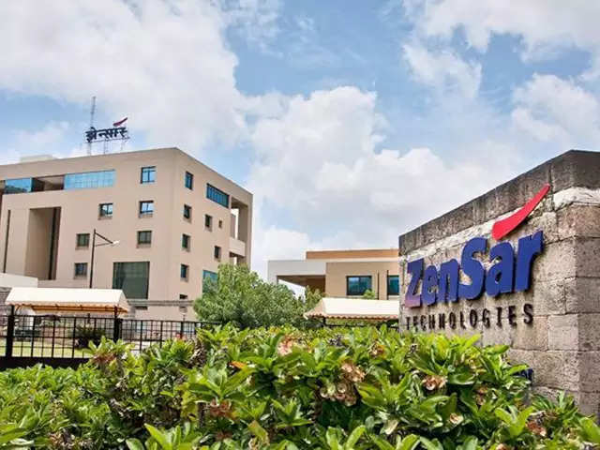
Founded in 1991, Pune
Present CEO Ajay S. Bhutoria
Listing date on Bombay Stock Exchange 07-September-2003
Listed on National Stock Exchange
Is Part of fortune 500 list
Technology consulting and services company over 10,000 associates in 33 global locations

Slide 3




ZENSAR’S CAMPUS CONNECT: ‘LEARNING BEFORE JOINING’ PROGRAM

Slide 4
IPT Flow: -
Domain
Learning Path
Assessments & Labs
Projects

Slide 5
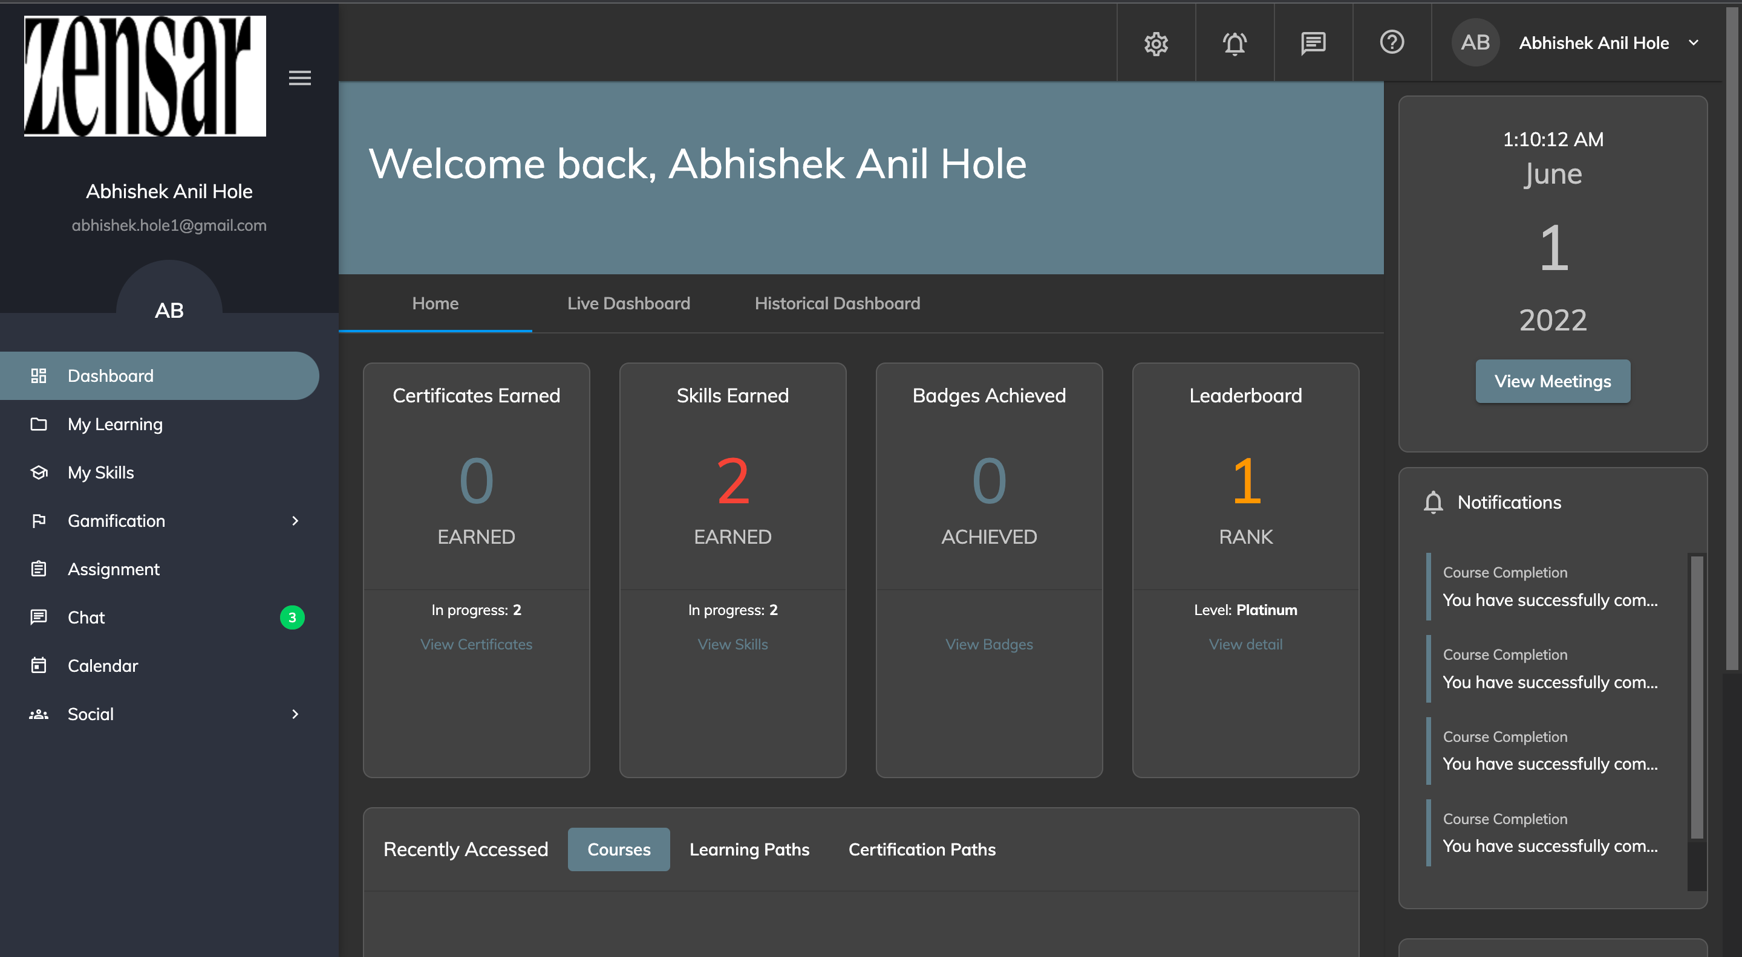

Slide 6
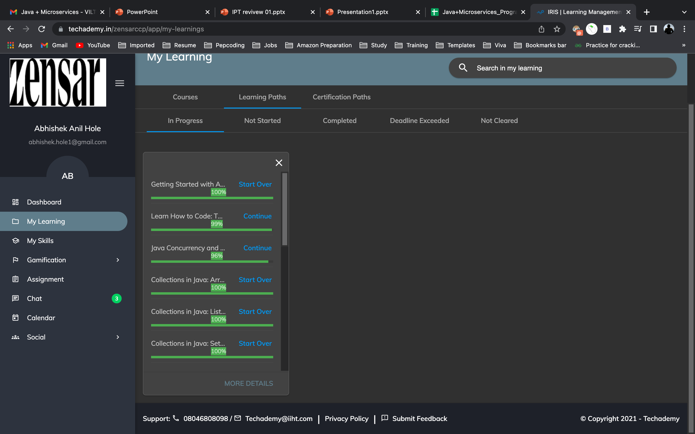
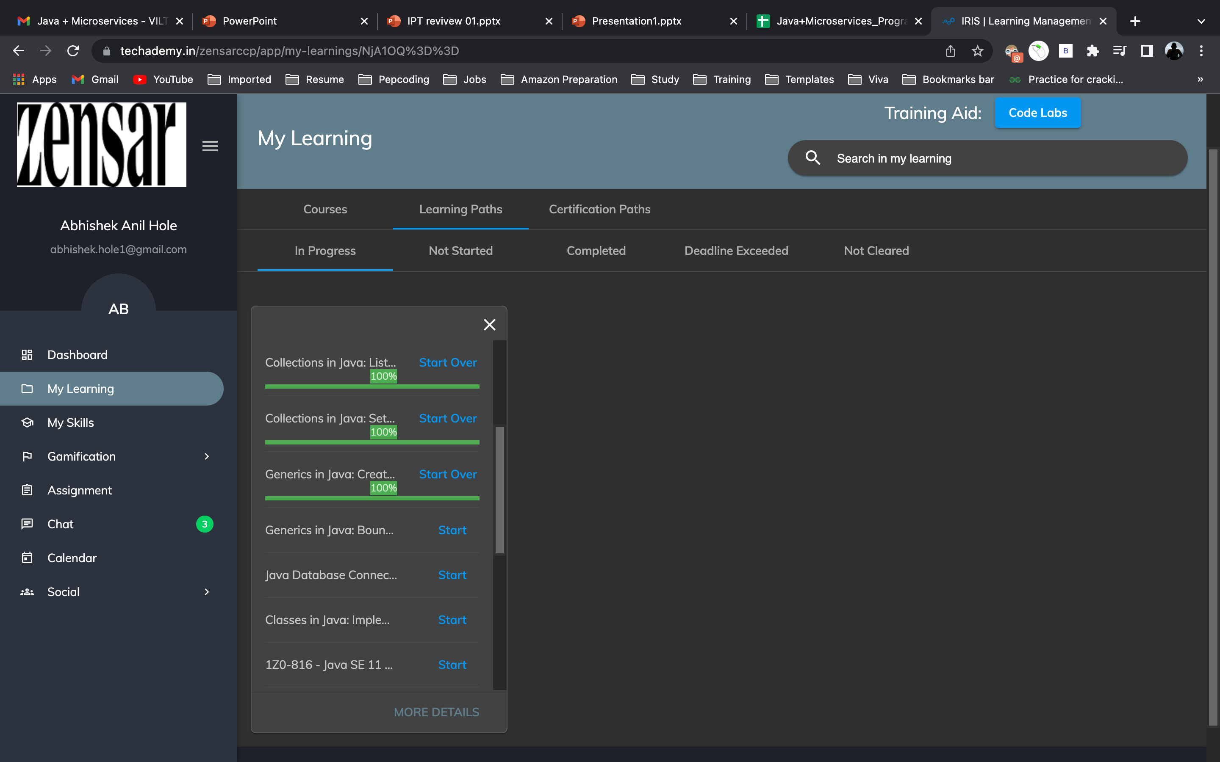
Java + Microservices learning path progress: -

Slide 7
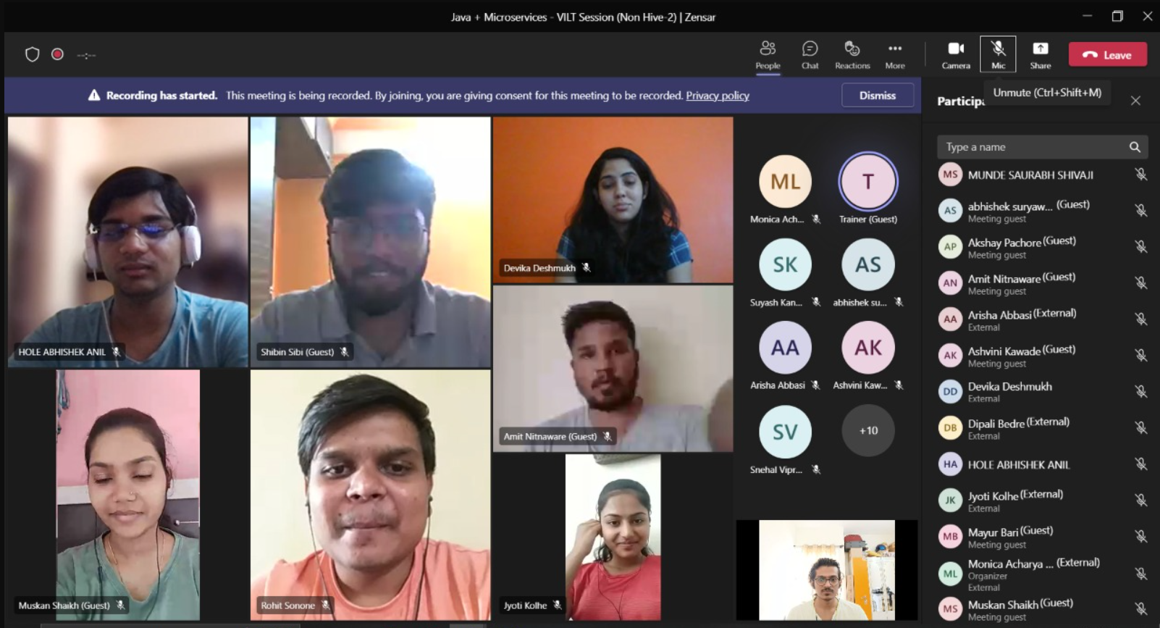
VILT Session

Slide 8
Thank You.

